Slide 1
Unit 10
Files I/O in C

Slide 2
Why files are needed?
When a program is terminated, the entire data is lost. Storing in a file will preserve your data even if the program terminates.
If you have to enter a large number of data, it will take a lot of time to enter them all. However, if you have a file containing all the data, you can easily access the contents of the file using few commands in C.
You can easily move your data from one computer to another without any changes.

Slide 3
Types of Files
When dealing with files, there are two types of files you should know about:
Text files
Binary files

Slide 4
1. Text files
Text files are the normal .txt files that you can easily create using Notepad or any simple text editors.
When you open those files, you'll see all the contents within the file as plain text. You can easily edit or delete the contents.
They take minimum effort to maintain, are easily readable, and provide least security and takes bigger storage space.

Slide 5
2. Binary files
Binary files are mostly the .bin files in your computer.
Instead of storing data in plain text, they store it in the binary form (0's and 1's).
They can hold higher amount of data, are not readable easily and provides a better security than text files.

Slide 6
File Operations
In C, you can perform four major operations on the file, either text or binary:
Creating a new file
Opening an existing file
Closing a file
Reading from and writing information to a file

Slide 7
Working with files
When working with files, you need to declare a pointer of type file. This declaration is needed for communication between the file and program.
FILE *fptr;

Slide 8
Opening a file - for creation and edit
Opening a file is performed using the library function in the "stdio.h" header file: fopen().
The syntax for opening a file in standard I/O is:
ptr = fopen("fileopen","mode")
For Example:
fopen("E:\\cprogram\\newprogram.txt","w");
fopen("E:\\cprogram\\oldprogram.bin","rb");

Slide 9
Let's suppose the file newprogram.txt doesn't exist in the location E:\cprogram. The first function creates a new file named newprogram.txt and opens it for writing as per the mode 'w'. The writing mode allows you to create and edit (overwrite) the contents of the file.
Now let's suppose the second binary file oldprogram.bin exists in the location E:\cprogram. The second function opens the existing file for reading in binary mode 'rb'. The reading mode only allows you to read the file, you cannot write into the file.

Slide 10
Opening Modes in Standard I/O
File Mode | Meaning of Mode | During Inexistence of file
r | Open for reading. | If the file does not exist, fopen() returns NULL.
rb | Open for reading in binary mode. | If the file does not exist, fopen() returns NULL.
w | Open for writing. | If the file exists, its contents are overwritten. If the file does not exist, it will be created.
wb | Open for writing in binary mode. | If the file exists, its contents are overwritten. If the file does not exist, it will be created.
a | Open for append. i.e, Data is added to end of file. | If the file does not exists, it will be created.
ab | Open for append in binary mode. i.e, Data is added to end of file. | If the file does not exists, it will be created.

Slide 11
File Mode | Meaning of Mode | During Inexistence of file
r+ | Open for both reading and writing. | If the file does not exist, fopen() returns NULL.
rb+ | Open for both reading and writing in binary mode. | If the file does not exist, fopen() returns NULL.
w+ | Open for both reading and writing. | If the file exists, its contents are overwritten. If the file does not exist, it will be created.
wb+ | Open for both reading and writing in binary mode. | If the file exists, its contents are overwritten. If the file does not exist, it will be created.
a+ | Open for both reading and appending. | If the file does not exists, it will be created.
ab+ | Open for both reading and appending in binary mode. | If the file does not exists, it will be created.

Slide 12
Closing a File
The file (both text and binary) should be closed after reading/writing.
Closing a file is performed using library function fclose().
fclose(fptr); //fptr is the file pointer associated with file to be closed.

Slide 13
Functions for file handling
No. | Function | Description
1 | fopen() | opens new or existing file
2 | fclose() | closes the file
3 | fprintf() | write formatted data into the file
4 | fscanf() | reads formatted data from the file
5 | fputc() | writes a character into the file
6 | fgetc() | reads a character from file
7 | fputs() | Writes a string to a file
8 | fgets() | Reads a string from a file
9 | putw() | writes an integer to file
10 | getw() | reads an integer from file
11 | fread() | It is used to read a block at a time
12 | fwrite() | It is used to write a block at a time

Slide 14
No. | Function | Description
9 | fseek() | sets the file pointer to given position
12 | ftell() | returns current position
13 | rewind() | sets the file pointer to the beginning of the file
14 | feof() | Returns true if end of file is reached
15 | ferror | Returns true if error has occured
16 | fflush() | Flushes a file
17 | remove() | Erases a file

Slide 15
Writing a character in a file
#include<stdio.h>
void main()
{
FILE *fp;
char c;
printf("enter a character");
scanf(" %c",&c);
fp = fopen("sample.txt", "w");
if(fp==NULL){
printf("Error while opening file");
exit(0);
}
fputc(c,fp);
fclose(fp);}

Slide 16
Read a character from a file
#include<stdio.h>
void main()
{
FILE *fp;
char c;
fp = fopen("sample.txt", "r");
printf("\ncontents of files are\n");
c=fgetc(fp);
printf("%c",c);
fclose(fp);
}
while(c!=EOF)
{
c=fgetc(fp);
printf("%c",c);
}

Slide 17
Writing a string in file
#include<stdio.h>
void main()
{
FILE *fp;
int result;
char c[100];
printf("enter a line");
gets(c);
fp = fopen("source.txt", "w");
fputs(c,fp);
fclose(fp);
}

Slide 18
Copying from source to destination
#include<stdio.h>
void main()
{
FILE *fp1,*fp2;
char c;
fp1 = fopen("source.txt", "r");
fp2 = fopen("dest.txt", "w");
if(fp1==NULL||fp2==NULL)
{
printf("Error while opening file");
exit(0);
}

Slide 19
printf("\ncopying content of files\n");
while((c=fgetc(fp1))!=EOF)
{
fputc(c,fp2);
}
fclose(fp1);
fclose(fp2);
}

Slide 20
Read String from file
#include<stdio.h>
void main()
{
FILE *fp;
int result;
char c[100];
fp = fopen("dest.txt", "r");
fgets(c,100,fp);
printf("%s",c);
fclose(fp);
}

Slide 21
Read and write formatted data
#include<stdio.h>
void main()
{
FILE *fp;
int x,a=10;
float y,b=5.5;
char z,c='M';
fp = fopen("form.txt", "w");
fprintf(fp,"%d %f %c\n",a,b,c);
fclose(fp);
fp=fopen("form.txt", "r");
fscanf(fp,"%d %f %c\n",&x,&y,&z);
printf("\n%d \n%f\n%c",x,y,z);}

Slide 22
Write and Read int into file
#include<stdio.h>
#include<conio.h>
#include<process.h>
void main()
{
FILE *fp;
int x,y;
fp = fopen("integ.txt", "a");
printf("enter a number");
scanf("%d",&x);
putw(x,fp);
fclose(fp);

Slide 23
fp = fopen("integ.txt", "r");
y=getw(fp);
while(y!=-1)
{
printf("%d",y);
y=getw(fp);
}
}

Slide 24
Writing a Block into a file
#include<stdio.h>
struct employee
{
char name[20];
int age;
float salary;
};
void main()
{
struct employee emp;
FILE *fp;
char c;
fp = fopen("student.txt", "w");

Slide 25
do
{
printf("\nenter name");
fflush(stdin);
gets(emp.name);
printf("\nenter age");
scanf("%d",&emp.age);
printf("\nenter salary");
scanf("%f",&emp.salary);
fwrite(&emp,sizeof(emp),1,fp);
printf("Want to add another record (y/n)");
scanf(" %c",&c);
}while(c=='y');
fclose(fp);
}

Slide 26
Reading a block from a file
#include<stdio.h>
struct employee
{
char name[20];
int age;
float salary;
};
void main()
{
struct employee emp;
FILE *fp;

Slide 27
fp = fopen("student.txt", "r");
while(fread(&emp,sizeof(emp),1,fp))
{
printf("\nname is %s\nage is %d\nsalary is%f",emp.name,emp.age,emp.salary);
printf("\n*******************");
}
fclose(fp);
}

Slide 28
Program to create a file named “university.dat”. Write a program to keep the records of N colleges under Tribhuwan University. These records contain name, location and no_of_faculties of the college abd display the names of colleges in kathmandu location

Slide 29
#include<stdio.h>
struct college
{
char name[20];
char location[20];
int faculty_no;
};
void main()
{
struct college col;
FILE *fp;
char c;
fp = fopen("university.dat", "wb+");

Slide 30
do
{
printf("\nenter college name");
fflush(stdin);
gets(col.name);
printf("\nenter college location");
fflush(stdin);
gets(col.location);
printf("\nenter no of faculties");
scanf("%d",&col.faculty_no);
fwrite(&col,sizeof(col),1,fp);
printf("Want to add another record (y/n)");
scanf(" %c",&c);
}while(c=='y');
rewind(fp);

Slide 31
fread(&col,sizeof(col),1,fp);
printf("name of colleges in kathmandu");
while(!feof(fp))
{
if(strcmp(col.location,"kathmandu")==0)
{
printf("\ncollege name is %s",col.name);
printf("\n*******************");
}
fread(&col,sizeof(col),1,fp);
}
fclose(fp);
}

Slide 32
Reading and writing to a binary file
Functions fread() and fwrite() are used for reading from and writing to a file on the disk respectively in case of binary files.
Writing to a binary file
To write into a binary file, you need to use the function fwrite(). The functions takes four arguments: Address of data to be written in disk, Size of data to be written in disk, number of such type of data and pointer to the file where you want to write.
fwrite(address_data,size_data,numbers_data,pointer_to_file);

Slide 33
Example 3: Write to a binary file using fwrite()
#include <stdio.h>
#include <stdlib.h>
struct threeNum
{
int n1, n2, n3;
};
int main()
{
int n;
struct threeNum num;
FILE *fptr;
if ((fptr = fopen("C:\\program.bin","wb")) == NULL){
printf("Error! opening file");
}

Slide 34
for(n = 1; n < 5; ++n)
{
num.n1 = n;
num.n2 = 5*n;
num.n3 = 5*n + 1;
fwrite(&num, sizeof(struct threeNum), 1, fptr);
}
fclose(fptr);
return 0;
}

Slide 35
Reading from a binary file
Function fread() also take 4 arguments similar to fwrite() function as above.
fread(address_data,size_data,numbers_data,pointer_to_file);

Slide 36
Example 4: Read from a binary file using fread()
#include <stdio.h>
#include <stdlib.h>
struct threeNum
{
int n1, n2, n3;
};
int main()
{
int n;
struct threeNum num;
FILE *fptr;
if ((fptr = fopen("C:\\program.bin","rb")) == NULL){
printf("Error! opening file");
}

Slide 37
for(n = 1; n < 5; ++n)
{
fread(&num, sizeof(struct threeNum), 1, fptr);
printf("n1: %d\tn2: %d\tn3: %d", num.n1, num.n2, num.n3);
}
fclose(fptr);
return 0;
}

Slide 38
Getting data using fseek()
If you have many records inside a file and need to access a record at a specific position, you need to loop through all the records before it to get the record.
This will waste a lot of memory and operation time. An easier way to get to the required data can be achieved using fseek().
As the name suggests, fseek() seeks the cursor to the given record in the file.

Slide 39
Syntax of fseek()
fseek(FILE * stream, long int offset, int whence)
The first parameter stream is the pointer to the file. The second parameter is the position of the record to be found, and the third parameter specifies the location where the offset starts.
Whence | Meaning
SEEK_SET | Starts the offset from the beginning of the file.
SEEK_END | Starts the offset from the end of the file.
SEEK_CUR | Starts the offset from the current location of the cursor in the file.

Slide 40
Statement | Meaning
fseek(fp,0,0) | Go to the beginning
fseek(fp,0,1) | Stay at current position
fseek(fp,0,2) | Go to the end of file, past the last character of the file
fseek(fp,m,0) | Move to (m+1)th byte in the file
fseek(fp,m,1) | Go forward by m bytes
fseek(fp,-m,1) | Go backward by m bytes from the current position
fseek(fp,-m,2) | Go backward by m bytes from the end.

Slide 41
Example
#include<stdio.h>
#include<conio.h>
void main()
{
FILE *fp;
char a,b[50];
fp=fopen("dest.txt","r");
fgets(b,50,fp);
printf("%s",b);
rewind(fp);

Slide 42
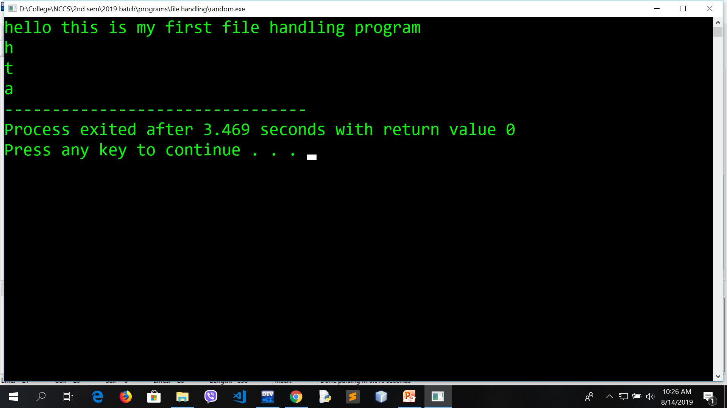
a=fgetc(fp);
printf("\n%c",a);
fseek(fp,6,0);
a=fgetc(fp);
printf("\n%c",a);
fseek(fp,-2,2);
a=fgetc(fp);
printf("\n%c",a);
fclose(fp);
}

Slide 43
#include <stdio.h>
#include <stdlib.h>
struct threeNum
{
int n1, n2, n3;
};
int main()
{
int n;
struct threeNum num;
FILE *fptr;
if ((fptr = fopen("C:\\program.bin","rb")) == NULL){
printf("Error! opening file");
exit(1);
}

Slide 44
// Moves the cursor to the end of the file
fseek(fptr, -sizeof(struct threeNum), SEEK_END);
for(n = 1; n < 5; ++n)
{
fread(&num, sizeof(struct threeNum), 1, fptr);
printf("n1: %d\tn2: %d\tn3: %d\n", num.n1, num.n2, num.n3);
fseek(fptr, -2*sizeof(struct threeNum), SEEK_CUR);
}
fclose(fptr);
return 0;
}

